Slide 1
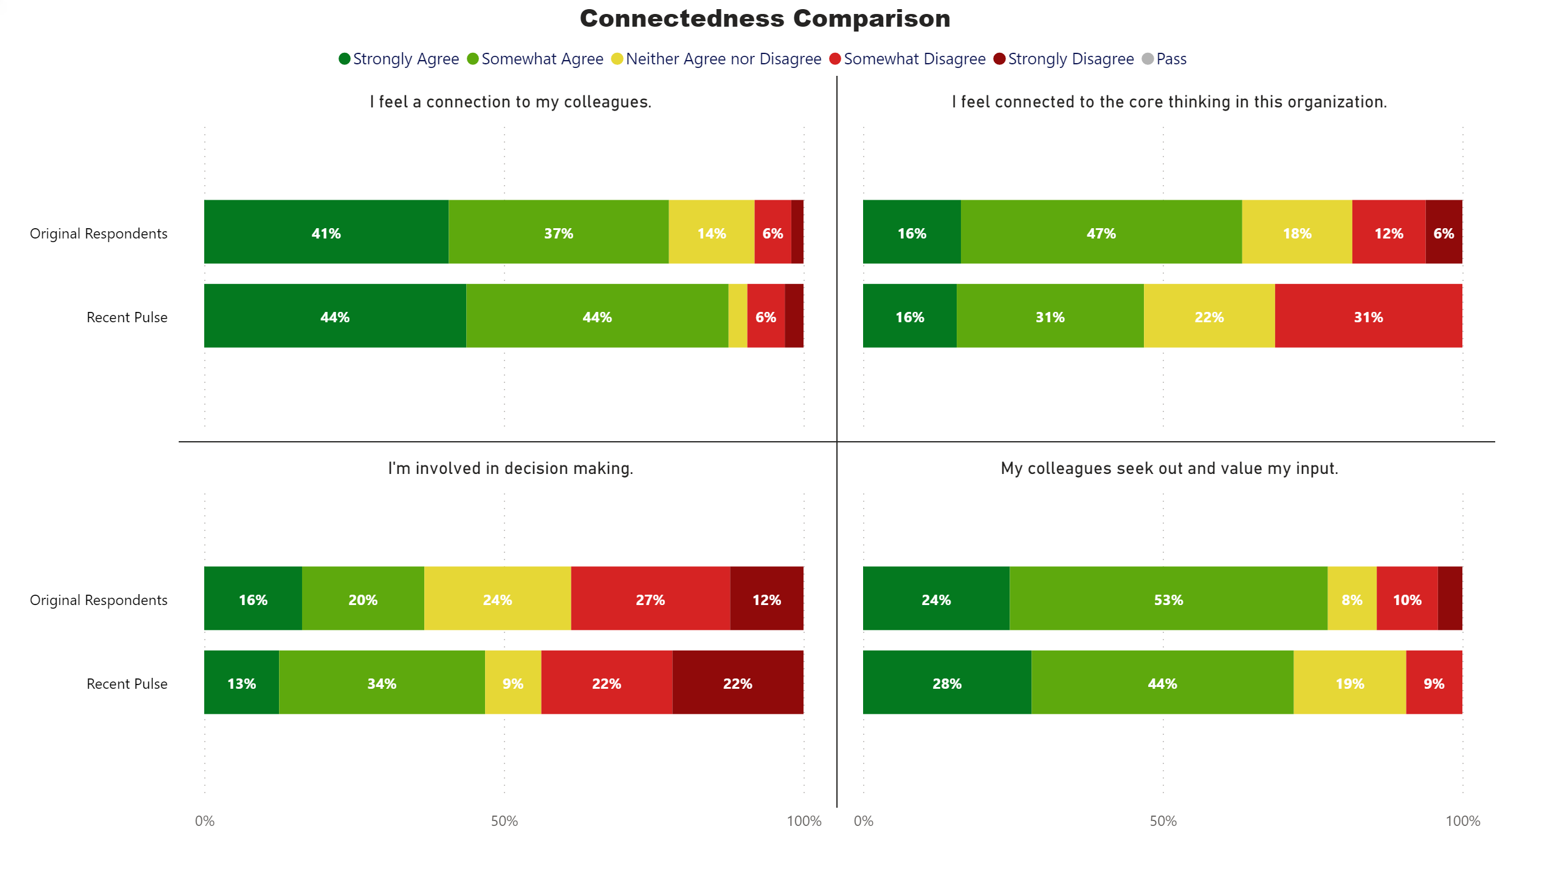
Connectedness Comparison
Notes:
Connectedness Comparison
No alt text provided.

